Slide 1

Chapter 9
Hypothesis Testing

Slide 2
Contents
Developing Null and Alternative Hypotheses
Type I and Type II Errors
Population Mean: σ Known
Population Mean: σ Unknown
Population Proportion

Slide 3
Hypothesis Testing
Hypothesis testing can be used to determine whether a statement about the value of a population parameter should or should not be rejected.
The null hypothesis, denoted by H₀ , is a tentative assumption about a population parameter.
The alternative hypothesis, denoted by H_{a}, is the opposite of what is stated in the null hypothesis.
The hypothesis testing procedure uses data from a sample to test the two competing statements indicated by H₀ and H_{a}.

Slide 4
Definition: Null and Alternative Hypotheses
A null hypothesis is a claim (or statement) about a population parameter that is assumed to be true until it is declared false.
An alternative hypothesis is a claim about a population parameter that will be declared true if the null hypothesis is declared to be false.

Slide 5
Developing Null and Alternative Hypotheses
It is not always obvious how the null and alternative hypotheses should be formulated.
Care must be taken to structure the hypotheses appropriately so that the test conclusion provides the information the researcher wants.
The context of the situation is very important in determining how the hypotheses should be stated.
In some cases it is easier to identify the alternative hypothesis first. In other cases the null is easier.
Correct hypothesis formulation will take practice.

Slide 6
Developing Null and Alternative Hypotheses
Alternative Hypothesis as a Research Hypothesis
Many applications of hypothesis testing involve an attempt to gather evidence in support of a research hypothesis.
In such cases, it is often best to begin with the alternative hypothesis and make it the conclusion that the researcher hopes to support.
The conclusion that the research hypothesis is true is made if the sample data provide sufficient evidence to show that the null hypothesis can be rejected.

Slide 7
Developing Null and Alternative Hypotheses
Alternative Hypothesis as a Research Hypothesis
Example:
A new teaching method is developed that is believed to be better than the current method.
Alternative Hypothesis:
The new teaching method is better.
Null Hypothesis:
The new method is no better than the old method.

Slide 8
Developing Null and Alternative Hypotheses
Alternative Hypothesis as a Research Hypothesis
Example:
A new sales force bonus plan is developed in an attempt to increase sales.
Alternative Hypothesis:
The new bonus plan increases sales.
Null Hypothesis:
The new bonus plan does not increase sales.

Slide 9
Developing Null and Alternative Hypotheses
Alternative Hypothesis as a Research Hypothesis
Example:
A new drug is developed with the goal of lowering blood pressure more than the existing drug.
Alternative Hypothesis:
The new drug lowers blood pressure more than the existing drug.
Null Hypothesis:
The new drug does not lower blood pressure more than the existing drug.

Slide 10
Developing Null and Alternative Hypotheses
Null Hypothesis formulation
We might begin with a belief or assumption that a statement about the value of a population parameter is true.
We then using a hypothesis test to challenge the assumption and determine if there is statistical evidence to conclude that the assumption is incorrect.
In these situations, it is helpful to develop the null hypothesis first.

Slide 11
Developing Null and Alternative Hypotheses
Null Hypothesis as an Assumption to be Challenged
Example:
The label on a soft drink bottle states that it contains 67.6 fluid ounces.
Null Hypothesis:
The label is correct. μ > 67.6 ounces.
Alternative Hypothesis:
The label is incorrect. μ < 67.6 ounces.

Slide 12
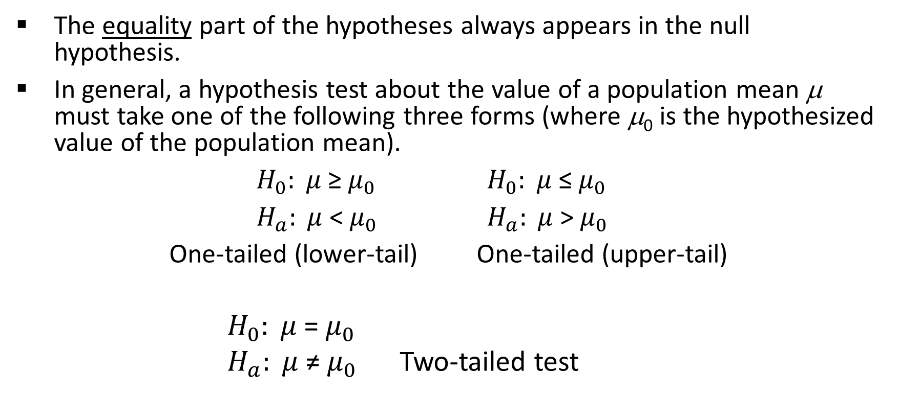
Summary of Forms for Null and Alternative Hypotheses about a Population Mean
The equality part of the hypotheses always appears in the null hypothesis.
In general, a hypothesis test about the value of a population mean μ must take one of the following three forms (where μ₀ is the hypothesized value of the population mean).
$H_{0}: μ$≥$μ_{0}$ $H_{0}: μ$≤$μ_{0}$
$H_{a}: μ$<$μ_{0}$ $H_{a}: μ$>$μ_{0}$
One-tailed (lower-tail) One-tailed (upper-tail)
$H_{0}: μ$=$μ_{0}$
$H_{a}: μ$≠$μ_{0}$ Two-tailed test

Slide 13
Null and Alternative Hypotheses
Example: Metro EMS
A major west coast city hospital provides one of the most comprehensive emergency medical services in the world. Operating in a multiple hospital system with approximately 20 mobile medical units, the service goal is to respond to medical emergencies with a mean time of 12 minutes or less.
The director of medical services wants to formulate a hypothesis test that could use a sample of emergency response times to determine whether or not the service goal of 12 minutes or less is being achieved.

Slide 14
Null and Alternative Hypotheses
H₀: μ < 12 The emergency service is meeting the response goal; no follow-up action is necessary.
H_{a}: μ > 12 The emergency service is not meeting the response goal; appropriate follow-up action is necessary.
where: μ = mean response time for the population
of medical emergency requests

Slide 15
Question for Practice: Null and Alternative Hypotheses
A production line operation is designed to fill cartons with laundry detergent to a mean weight of 32 ounces. A sample of cartons is periodically selected and weighed to determine whether underfilling or overfilling is occurring. If the sample data lead to a conclusion of underfilling or overfilling, the production line will be shut down and adjusted to obtain proper filling.
Formulate the null and alternative hypotheses that will help in deciding whether to shut down and adjust the production line.
Comment on the conclusion and the decision when h₀ cannot be rejected.
Comment on the conclusion and the decision when h₀ can be rejected.

Slide 16
Question for Practice: Null and Alternative Hypotheses
The manager of an automobile dealership is considering a new bonus plan designed to increase sales volume. Currently, the mean sales volume is 14 automobiles per month. The manager wants to conduct a research study to see whether the new bonus plan increases sales volume. To collect data on the plan, a sample of sales personnel will be allowed to sell under the new bonus plan for a one-month period.
a. Develop the null and alternative hypotheses most appropriate for this situation.
b. Comment on the conclusion when h₀ cannot be rejected.
c. Comment on the conclusion when h₀ can be rejected.

Slide 17
Question for Practice: Null and Alternative Hypotheses
Because of high production-changeover time and costs, a director of manufacturing must convince management that a proposed manufacturing method reduces costs before the new method can be implemented. The current production method operates with a mean cost of $220 per hour. A research study will measure the cost of the new method over a sample production period.
a. Develop the null and alternative hypotheses most appropriate for this study.
b. Comment on the conclusion when h₀ cannot be rejected.
c. Comment on the conclusion when h₀ can be rejected

Slide 18
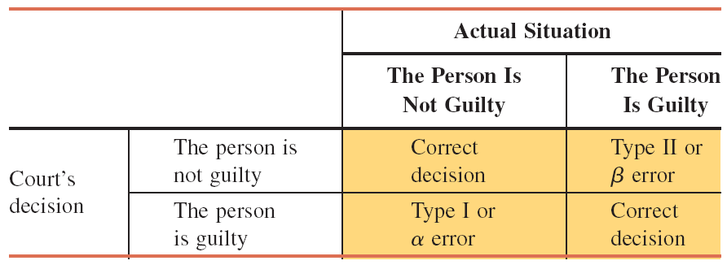
Type I and Type II Errors
Example: Four Possible Outcomes for a Court Case

Slide 19
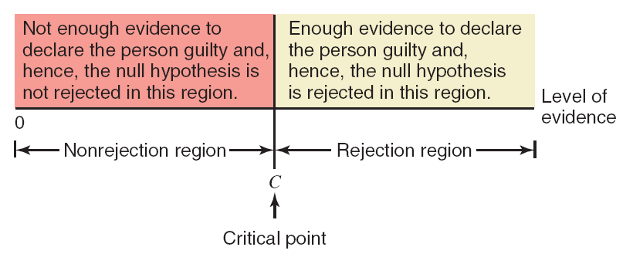
Rejection and Nonrejection Regions
Nonrejection and rejection regions for the court case.

Slide 20
Type I and Type II Errors
Population (Actual) Condition
Example: Metro EMS
H₀ True
(μ < 12)
H₀ False
(μ > 12)
Test Conclusion
Accept H₀
(Conclude μ < 12)
Correct
Decision
Type II Error
Reject H₀
(Conclude μ > 12)
Type I Error
Correct
Decision

Slide 21
Type I Error
Because hypothesis tests are based on sample data, we must allow for the possibility of errors.
A Type I error is rejecting H₀ when it is true.
The probability of making a Type I error when the null hypothesis is true as an equality is called the level of significance.
Applications of hypothesis testing that only control the Type I error are often called significance tests.

Slide 22
Type II Error
A Type II error is accepting H₀ when it is false.
It is difficult to control the probability of making a Type II error.
Statisticians avoid the risk of making a Type II error by using “do not reject H₀” and not “accept H₀”.

Slide 23
Tails of a Test
A two-tailed test has rejection regions in both tails, a left-tailed test has the rejection region in the left tail, and a right-tailed test has the rejection region in the right tail of the distribution curve.

Slide 24
A Two-Tailed Test
According to the U.S. Bureau of Labor Statistics, people in the United States who had a bachelor’s degree and were employed earned an average of $1038 a week in 2010. Suppose an economist wants to check whether this mean has changed since 2010. The key word here is changed.
The mean weekly earning of employed Americans with a bachelor’s degree has changed if it is either increased or decreased since 2010. This is an example of a two tailed test.

Slide 25
A Two-Tailed Test
Let μ be the mean weekly earning of employed Americans with a bachelor’s degree. The two possible decisions are
H0 : μ = $1038 (The mean weekly earning of employed Americans with a bachelor’s degree has not changed since 2010)
H1 : μ ≠ $1038 (The mean weekly earning of employed Americans with a bachelor’s degree has changed since 2010)
Whether a test is two–tailed or one–tailed is determined by the sign in the alternative hypothesis.
If the alternative hypothesis has a not equal to (≠) sign, it is a two–tailed test.

Slide 26
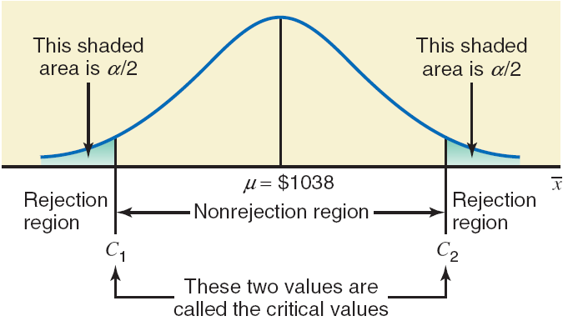
A Two-Tailed Test

Slide 27
A Left-Tailed Test
Reconsider the example of the mean amount of soda in all soft-drink cans produced by a company. The company claims that these cans, on average, contain 12 ounces of soda. However, if these cans contain less than the claimed amount of soda, then the company can be accused of cheating. Suppose a consumer agency wants to test whether the mean amount of soda per can is less than 12 ounces. Note that the key phrase this time is less than, which indicates a left-tailed test.

Slide 28
A Left-Tailed Test
Let μ be the mean amount of soda in all cans. The two possible decisions are
H0 : μ = 12 ounces (The mean is equal to 12 ounces)
H1 : μ < 12 ounces (The mean is less than 12 ounces)
In this case, we can also write the null hypothesis as H0 : μ ≥ 12. This will not affect the result of the test as long as the sign in H1 is less than (<).
When the alternative hypothesis has a less than (<) sign, the test is always left–tailed.

Slide 29
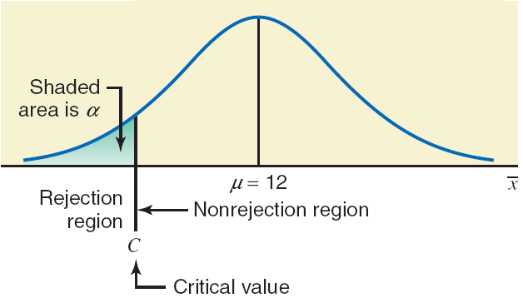
A Left-Tailed Test

Slide 30
A Right-Tailed Test
According to www.city-data.com, the average price of homes in West Orange, New Jersey, was $459,204 in 2009. Suppose a real estate researcher wants to check whether the current mean price of homes in this town is higher than $459,204. The key phrase in this case is higher than, which indicates a right-tailed test.

Slide 31
A Right-Tailed Test
Let μ be the current mean price of homes in this town. The two possible decisions are
H0 : μ = $459,204 (The current mean price of homes in this town is not higher than $459,204)
H1 : μ > $459,204 (The current mean price of homes in this town is higher than $459,204)
When the alternative hypothesis has a greater than (>) sign, the test is always right–tailed.

Slide 32
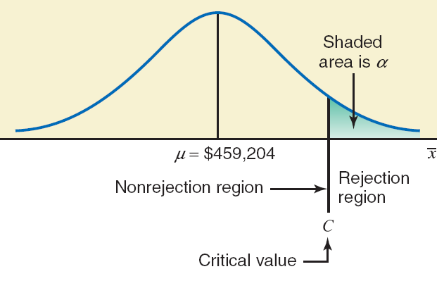
A Right-Tailed Test

Slide 33
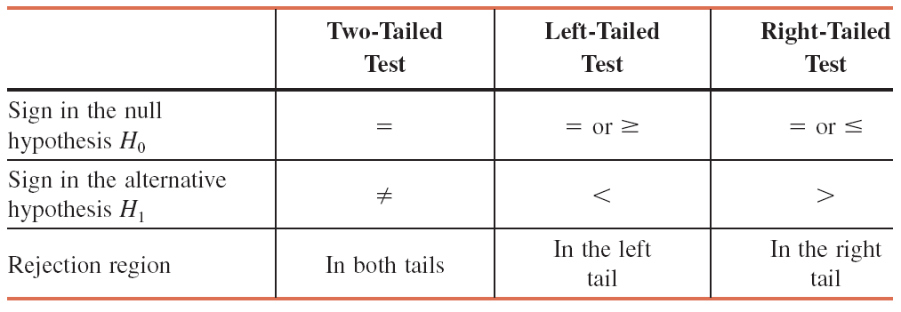
Summary: Signs in H₀ and H_{a} and Tails of a Test

Slide 34
Steps of Hypothesis Testing
Step 1. Develop the null and alternative hypotheses.
Step 2. Specify the level of significance α.
Step 3. Collect the sample data and compute the value of the test statistic.
p-Value Approach
Step 4. Use the value of the test statistic to compute the p-value.
Step 5. Reject H₀ if p-value < α.

Slide 35
Steps of Hypothesis Testing
Critical Value Approach
Step 4. Use the level of significance α to determine the critical value and the rejection rule.
Step 5. Use the value of the test statistic and the rejection rule to determine whether to reject H₀.

Slide 36
p-Value Approach to One-Tailed Hypothesis Testing
The p-value is the probability computed using the test statistic, that measures the support (or lack of support) provided by the sample for the null hypothesis.
If the p-value is less than or equal to the level of significance α, the value of the test statistic is in the rejection region.
Reject H₀ if the p-value < α .

Slide 37
Suggested Guidelines for Interpreting p-Values
Less than .01
Overwhelming evidence to conclude H_{a} is true.
Between .01 and .05
Strong evidence to conclude H_{a} is true.
Between .05 and .10
Weak evidence to conclude H_{a} is true.
Greater than .10
Insufficient evidence to conclude H_{a} is true.

Slide 38
Critical Value Approach to One-Tailed Hypothesis Testing
The test statistic z has a standard normal probability distribution.
We can use the standard normal probability distribution table to find the z-value with an area of a in the lower (or upper) tail of the distribution.
The value of the test statistic that establishes the boundary of the rejection region is called the critical value for the test.
The rejection rule is:
Lower tail: Reject H₀ if z < -z_{α}
Upper tail: Reject H₀ if z > z_{α}

Slide 39
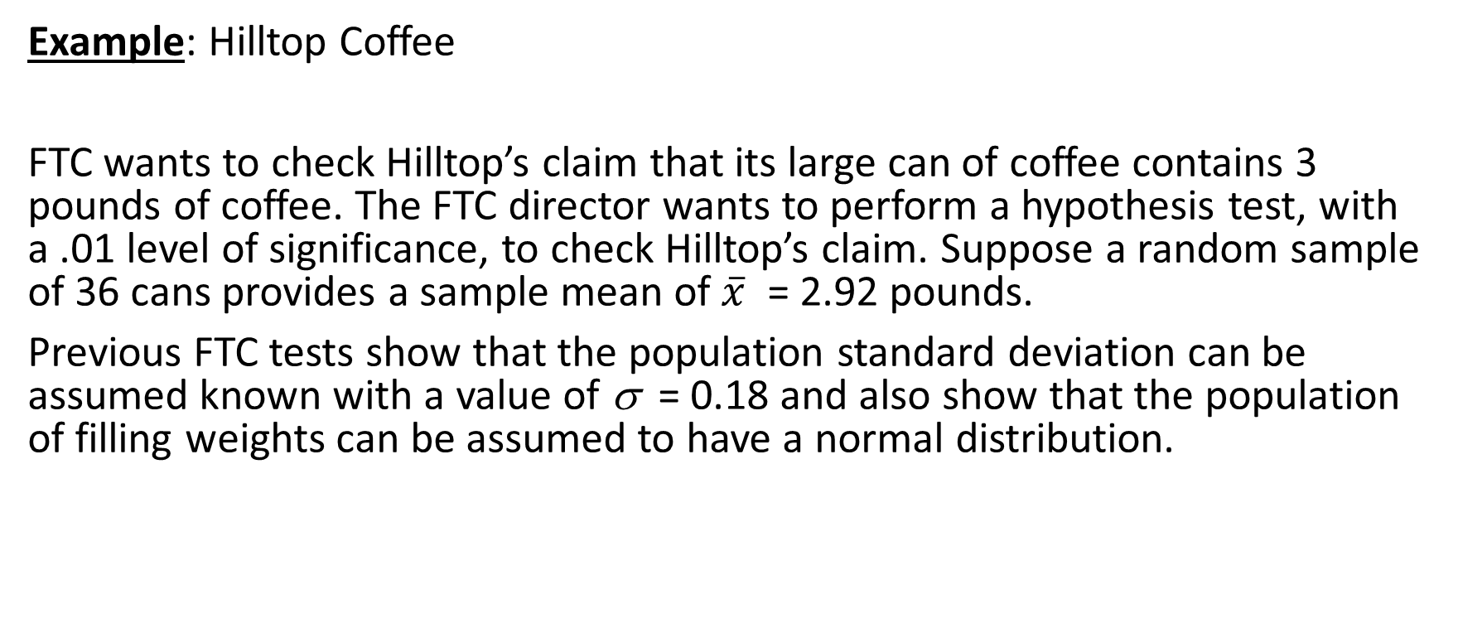
Lower-Tailed Test About a Population Mean: σ Known
Example: Hilltop Coffee
FTC wants to check Hilltop’s claim that its large can of coffee contains 3 pounds of coffee. The FTC director wants to perform a hypothesis test, with a .01 level of significance, to check Hilltop’s claim. Suppose a random sample of 36 cans provides a sample mean of $\overline{x}$ = 2.92 pounds.
Previous FTC tests show that the population standard deviation can be assumed known with a value of σ = 0.18 and also show that the population of filling weights can be assumed to have a normal distribution.

Slide 40
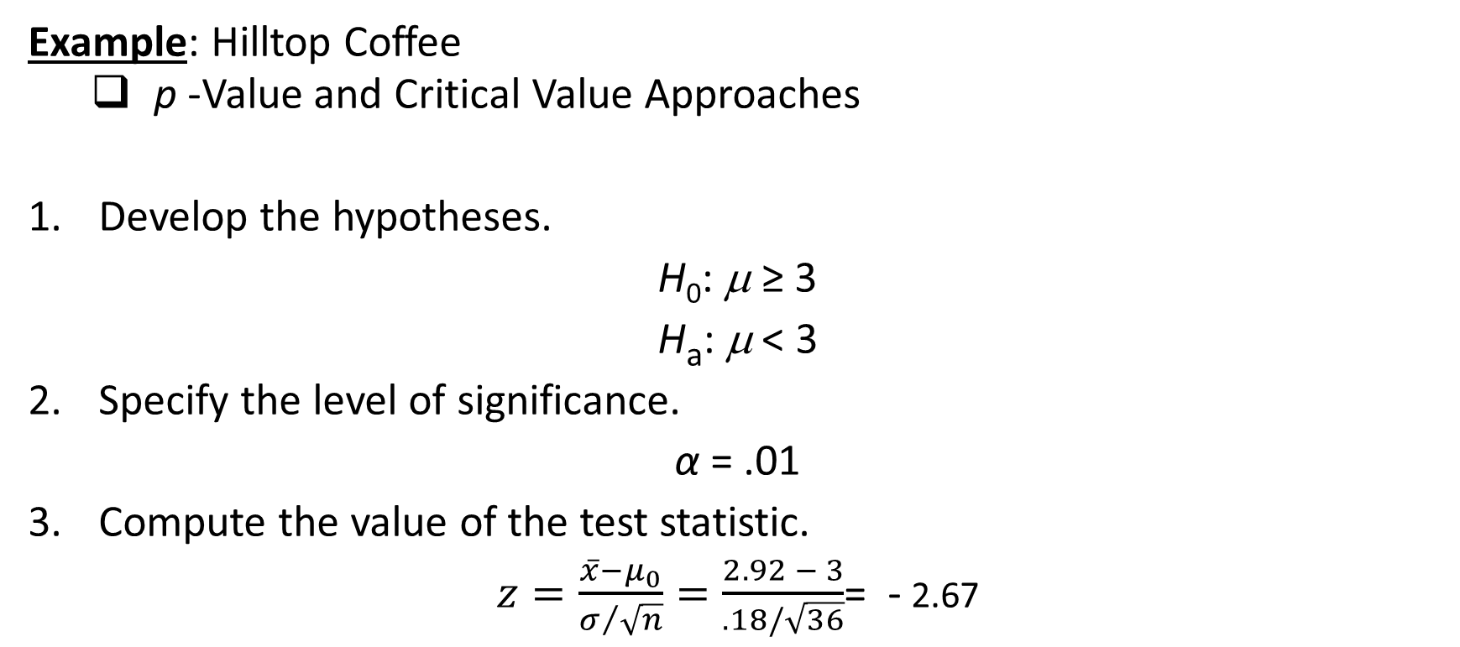
One-Tailed Tests About a Population Mean: σ Known
Example: Hilltop Coffee
p -Value and Critical Value Approaches
Develop the hypotheses.
H₀: μ ≥ 3
H_{a}: μ < 3
Specify the level of significance.
α = .01
Compute the value of the test statistic.
$z=\frac{\overline{x}−μ_{0}}{σ/{\sqrt{n}}}=\frac{2.92 − 3}{.18/\sqrt{36}}$= - 2.67

Slide 41
One-Tailed Tests About a Population Mean: σ Known
Example: Hilltop Coffee
Critical Value Approach
4. Determine the critical value and rejection rule.
For α = .01, z = -2.33
Reject H₀ if z ≤ -2.33
5. Determine whether to reject H₀.
Because -2.67 < -2.33, we reject H₀.
We conclude that Hilltop Coffee is underfilling cans.

Slide 42
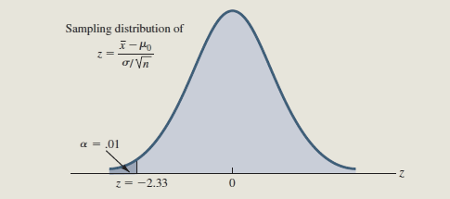
Critical Value Approach to One-Tailed Hypothesis Testing
Example: Hilltop Coffee
Reject H₀
Do Not Reject H₀

Slide 43
One-Tailed Tests About a Population Mean: σ Known
Example: Hilltop Coffee
p –Value Approach
Compute the p –value.
For z = - 2.67, using standard normal probability, we find that the lower tail area is .0038.
Determine whether to reject H₀.
Because p-value = .0038 < α = .01, we reject H₀.

Slide 44
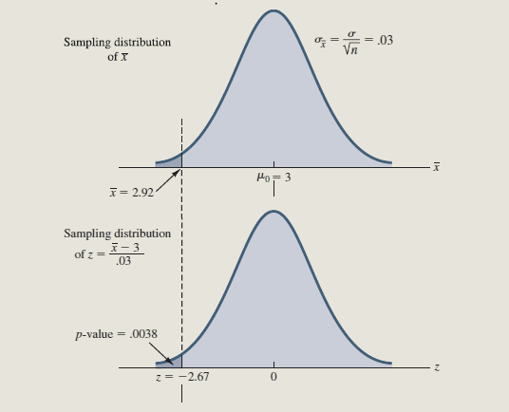
Lower-Tailed Test About a Population Mean: σ Known
Example: Hilltop Coffee
p-Value < α ,
so reject H₀.

Slide 45
p-Value Approach to Two-Tailed Hypothesis Testing
Compute the p-value using the following three steps:
Compute the value of the test statistic z.
If z is in the upper tail (z > 0), compute the probability that z is greater than or equal to the value of the test statistic. If z is in the lower tail (z < 0), compute the probability that z is less than or equal to the value of the test statistic.
Double the tail area obtained in step 2 to obtain the p-value.
The rejection rule: Reject H₀ if the p-value < α .

Slide 46
Critical Value Approach to Two-Tailed Hypothesis Testing
The critical values will occur in both the lower and upper tails of the standard normal curve.
Use the standard normal probability distribution table to find z_{α/2} (the z-value with an area of α/2 in the upper tail of the distribution).
The rejection rule is: Reject H₀ if z < -z_{α/2} or z > z_{α/2}.

Slide 47
Two-Tailed Tests About a Population Mean: σ Known
Example: MaxFlight Inc.
MaxFlight produces golf balls with a mean driving distance of 295 yards. Its quality control program involves taking periodic samples of 50 golf balls to monitor the manufacturing process.
Quality assurance procedures call for the continuation of the process if the sample results are consistent with the assumption that the mean driving distance for the population of golf balls is 295 yards; otherwise the process will be adjusted

Slide 48
Two-Tailed Tests About a Population Mean: σ Known
Example: MaxFlight Inc.
Assume that a sample of 50 golf balls provided a sample mean of 297.6 yards. The population standard deviation is believed to be 12 yards.
Perform a hypothesis test, at the .05 level of significance, to help determine whether the ball manufacturing process should continue operating or be stopped and corrected.

Slide 49
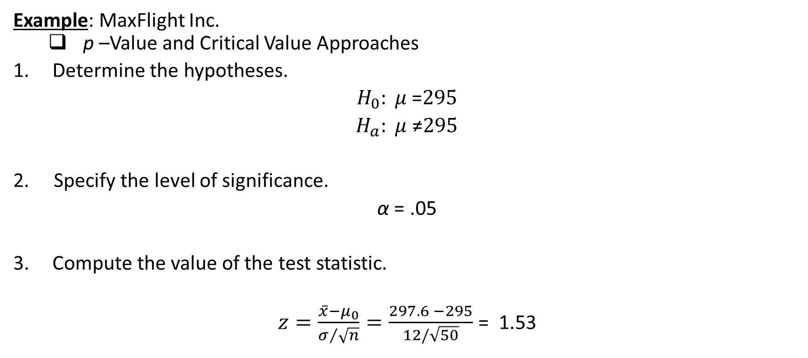
Two-Tailed Tests About a Population Mean: σ Known
Example: MaxFlight Inc.
p –Value and Critical Value Approaches
Determine the hypotheses.
$H_{0}: μ$=$295$
$H_{a}: μ$≠$295$
2. Specify the level of significance.
α = .05
Compute the value of the test statistic.
$z=\frac{\overline{x}−μ_{0}}{σ/{\sqrt{n}}}=\frac{297.6 −295}{12/\sqrt{50}}$ = 1.53

Slide 50
Two-Tailed Tests About a Population Mean: σ Known
Example: MaxFlight Inc.
Critical Value Approach
Determine the critical value and rejection rule.
For α/2 = .05/2 = .025, z_{.025} = 1.96
Reject H₀ if z < - 1.96 or z > 1.96
Determine whether to reject H₀.
Because 1.53 < 1.96, we cannot reject H₀.
There is sufficient statistical evidence to
infer that the null hypothesis cannot be rejected.

Slide 51
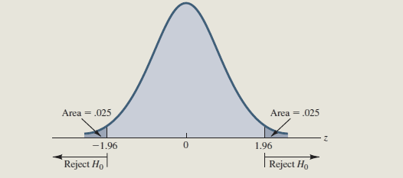
Two-Tailed Tests About a Population Mean: σ Known
Example: MaxFlight Inc.
Critical Value Approach

Slide 52
Two-Tailed Tests About a Population Mean: σ Known
Example: MaxFlight Inc.
p –Value Approach
Compute the p –value.
For z = 1.53, the standard normal distribution table shows, P(z < 1.53) = .9370
p-value = 2(1 - .9370) = .1260
Determine whether to reject H₀.
Because p-value = .1260 > α = .05, we do not reject H₀
There is sufficient statistical evidence to infer that the null hypothesis is true and so no action needs to be taken to adjust MaxFlight’s manufacturing process.

Slide 53
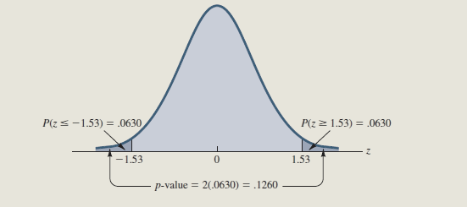
Two-Tailed Tests About a Population Mean: σ Known
Example: MaxFlight Inc.
p-Value Approach

Slide 54

Tests About a Population Mean: σ Unknown
Test Statistic:
$$t=\frac{\overline{x}−μ_{0}}{s/{\sqrt{n}}}$$
This test statistic has a t distribution with n - 1 degrees of freedom.

Slide 55
Tests About a Population Mean: σ Unknown
Rejection Rule: p -Value Approach
Reject H₀ if p –value < α
Rejection Rule: Critical Value Approach
H₀: μ > μ₀ Reject H₀ if t < -t_{α}
H₀: μ < μ₀ Reject H₀ if t > t_{α}
H₀: μ = μ₀ Reject H₀ if t < - t_{α/2} or t > t_{α/2}

Slide 56
p -Values and the t Distribution
The format of the t distribution table provided in most statistics textbooks does not have sufficient detail to determine the exact p-value for a hypothesis test.
However, we can still use the t distribution table to identify a range for the p-value.
An advantage of computer software packages is that the computer output will provide the p-value for the t distribution.

Slide 57
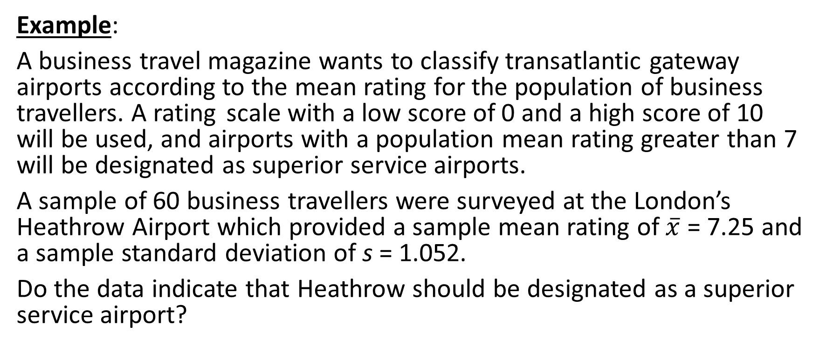
p -Values and the t Distribution
Example:
A business travel magazine wants to classify transatlantic gateway airports according to the mean rating for the population of business travellers. A rating scale with a low score of 0 and a high score of 10 will be used, and airports with a population mean rating greater than 7 will be designated as superior service airports.
A sample of 60 business travellers were surveyed at the London’s Heathrow Airport which provided a sample mean rating of $\overline{x}$ = 7.25 and a sample standard deviation of s = 1.052.
Do the data indicate that Heathrow should be designated as a superior service airport?

Slide 58
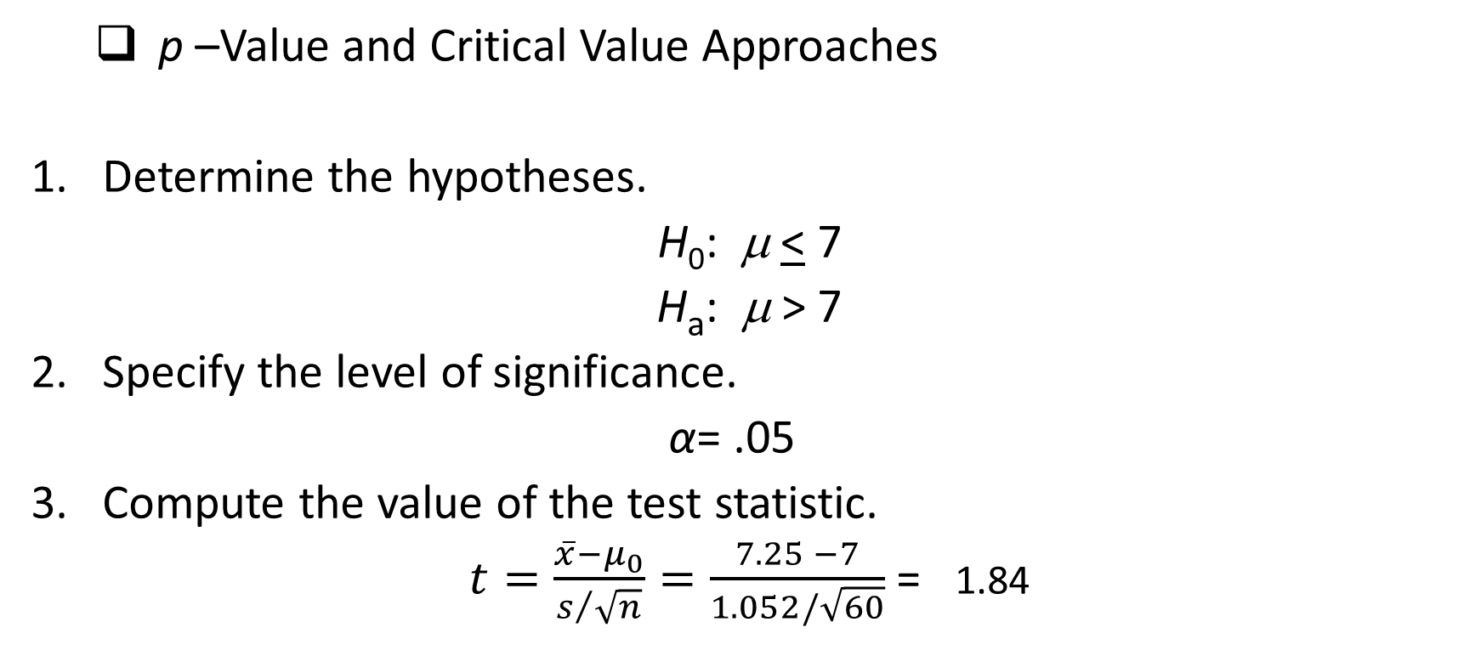
One-Tailed Test About a Population Mean: σ Unknown
p –Value and Critical Value Approaches
Determine the hypotheses.
H₀: μ < 7
H_{a}: μ > 7
Specify the level of significance.
α= .05
Compute the value of the test statistic.
$t=\frac{\overline{x}−μ_{0}}{s/{\sqrt{n}}}=\frac{7.25 −7}{1.052/\sqrt{60}}$ = 1.84

Slide 59
One-Tailed Test About a Population Mean: σ Unknown
p –Value Approach
Compute the p –value.
For t = 1.84, the p-value must be less than .05
(for t = 1.671) and greater than .025 (for t = 2.001).
.025 < p–value < .05
Determine whether to reject H₀.
Because p-value < α = .05, we reject H₀.
We reject the null hypothesis. Heathrow should be classified as a superior service airport.

Slide 60
One-Tailed Test About a Population Mean: σ Unknown
Critical Value Approach
Determine the critical value and rejection rule.
For α = .05 and d.f. = 60 – 1 = 59, t_{.05} = 1.671
Reject H₀ if t > 1.671
Determine whether to reject H₀.
Because 1.84 > 1.669, we reject H₀. Heathrow should be classified as a superior service airport.

Slide 61
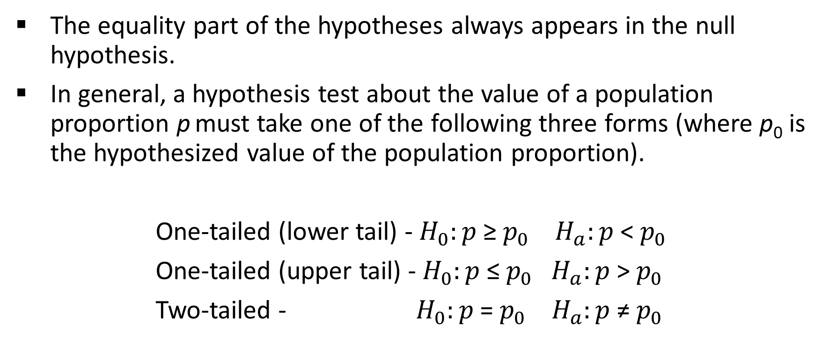
A Summary of Forms for Null and Alternative Hypotheses About a Population Proportion
The equality part of the hypotheses always appears in the null hypothesis.
In general, a hypothesis test about the value of a population proportion p must take one of the following three forms (where p₀ is the hypothesized value of the population proportion).
One-tailed (lower tail) - $H_{0}:p$≥$p_{0}$ $H_{a}:p$<$p_{0}$
One-tailed (upper tail) - $H_{0}:p$≤$p_{0}{ H}_{a}:p$>$p_{0}$
Two-tailed - $H_{0}:p$=$p_{0}$ $H_{a}:p$≠$p_{0}$

Slide 62

Tests About a Population Proportion
Test Statistic: $z=\frac{\overline{p}−p_{0}}{σ_{\overline{p}}}$
where: $σ_{\overline{p}}=\sqrt{\frac{p_{0}\left(1−p_{0}\right)}{n}}$
assuming np > 5 and n(1 – p) > 5

Slide 63
Tests About a Population Proportion
Rejection Rule: p –Value Approach
Reject H₀ if p –value < α
Rejection Rule: Critical Value Approach
H₀: p < p₀ Reject H₀ if z > z_{α}
H₀: p > p₀ Reject H₀ if z < -z_{α}
H₀: p = p₀ Reject H₀ if z < -z_{α/2} or z > z_{α/2}

Slide 64
Tests About a Population Proportion
Example: Pine Creek golf course
Over the past year, 20% of the players at Pine Creek were women. In an effort to increase the proportion of women players, Pine Creek implemented a special promotion design to attract women golfers. The manager now wants to determine if the proportion of women players has increased.
A random sample of 400 players were selected and 100 of the players were women. The level of significance is α = .05.

Slide 65
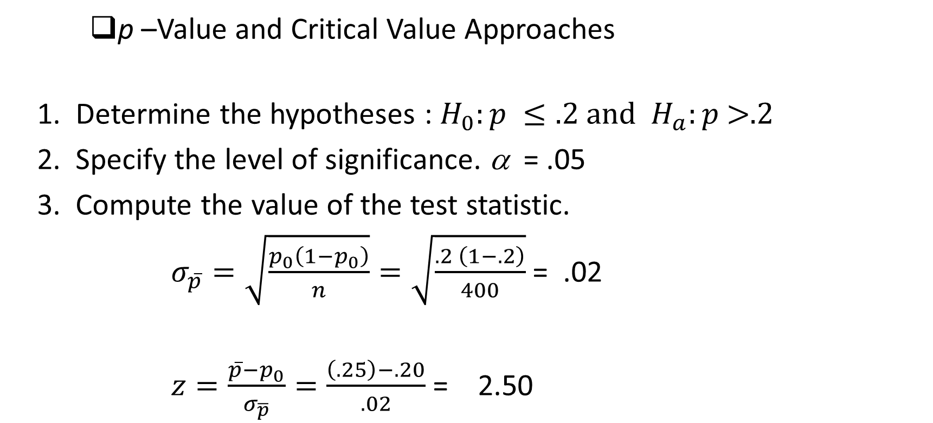
Tests About a Population Proportion
p –Value and Critical Value Approaches
1. Determine the hypotheses : $H_{0}:p ≤.2 and{ H}_{a}:p \text{>.2}$
2. Specify the level of significance. α = .05
3. Compute the value of the test statistic.
$σ_{\overline{p}}=\sqrt{\frac{p_{0}\left(1−p_{0}\right)}{n}}=\sqrt{\frac{.2 \left(1−.2\right)}{400}}$ = .02
$z=\frac{\overline{p}−p_{0}}{σ_{\overline{p}}}=\frac{\left(.25\right)−.20}{.02}$ = 2.50

Slide 66
Tests About a Population Proportion
p-Value Approach
4. Compute the p -value.
For z = 2.5, lower tail area = .9938
p-value = (1 - .9938) = .0062
5. Determine whether to reject H₀.
Because p-value = .0062 < α = .05, we reject H₀.

Slide 67
Tests About a Population Proportion
Critical Value Approach
Determine the critical values and rejection rule.
z_{.05} = 1.645
Reject H₀ z > 1.645
Determine whether to reject H₀.
Because z = 2.5 is > 1.645 we reject H₀.

Slide 68
Questions for Practice
Young millennials, adults aged 18 to 34, are viewed as the future of the restaurant industry (NPD Group). During 2011, this group consumed a mean of 192 restaurant meals per person. Conduct a hypothesis test to determine if the poor economy caused a change in the frequency of consuming restaurant meals by young millennials in 2012.
a. Formulate hypotheses that can be used to determine whether the annual mean number of restaurant meals per person has changed for young millennials in 2012.
b. Based on a sample, the NPD group stated that the mean number of restaurant meals consumed by young millennials in 2012 was 182. Assume the sample size was 150 and that, based on past studies, the population standard deviation can be assumed to be σ = 55. Use the sample results to compute the test statistic and p-value for your hypothesis test.
c. At α = .05, what is your conclusion?

Slide 69
Questions for Practice
The national mean annual salary for a school administrator is $90,000 a year (Cincinnati Enquirer, April 7, 2012). A school official took a sample of 25 school administrators in the state of Ohio to learn about salaries in that state to see if they differed from the national average.
a. Formulate hypotheses that can be used to determine whether the population mean annual administrator salary in Ohio differs from the national mean of $90,000.
b. The sample data for 25 Ohio administrators is contained in the file named ADMINISTRATOR. What is the p-value for your hypothesis test in part (a)?
c. At a = .05, can your null hypothesis be rejected? What is your conclusion?
d. Repeat the preceding hypothesis test using the critical value approach.

Slide 70
End of Chapter 9

